Slide 1
Head Localization
Sophie Kaltenleithner, Simone Sandler

Slide 2
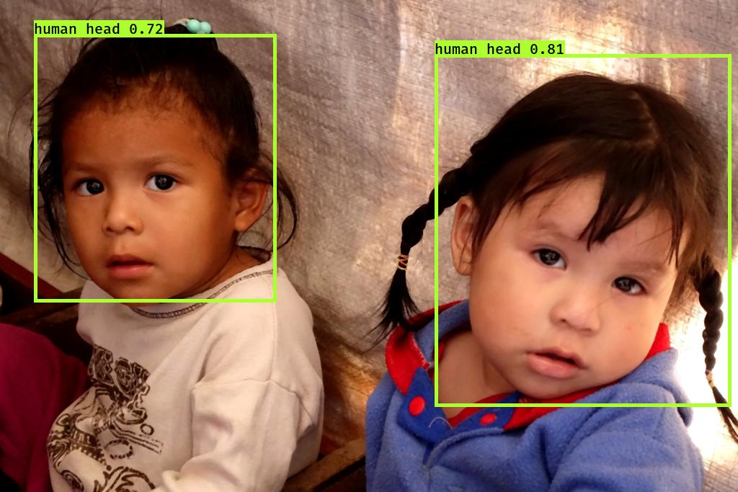
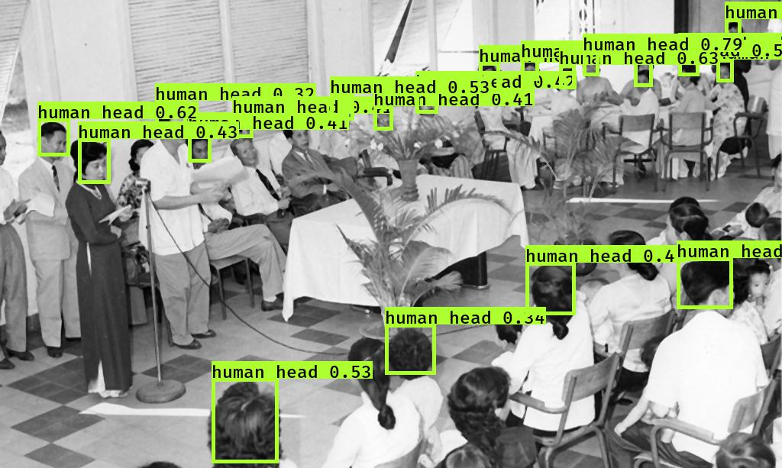
Goal: Localize human heads

Slide 3
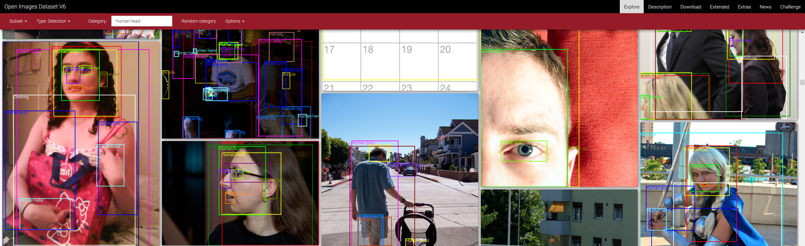
Dataset
Open Images v6
Provides bounding boxes for 600 categories
Human head was used as ground truth

Slide 4

Method
YOLO v3 network
Combines:
bounding boxes
classification
confidences
Pretrained weights from darknet
Transfer learning
Stage 1: freeze pretrained weights
Final Stage: unfreeze pretrained weights

Slide 5
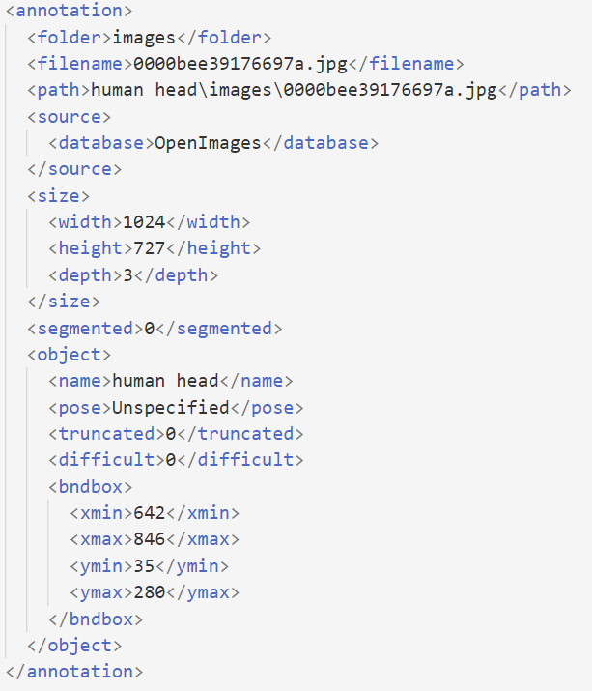
Preprocessing
Transform data annotations (Pascal VOC XML -> YOLO Darknet TXT)
Split into train/validation and test:
4500 train/validation
500 test
Median filter
Histogram equalization

Slide 6
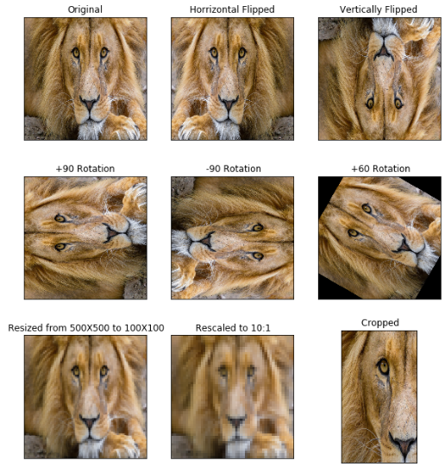
Data Augmentation
We used:
Zoom
Translation
Flipping (left-right)
Conversion to gray-scale
Image distortion by assigning a new random aspect ratio
Random color distortion by adjusting the HSV-values

Slide 7
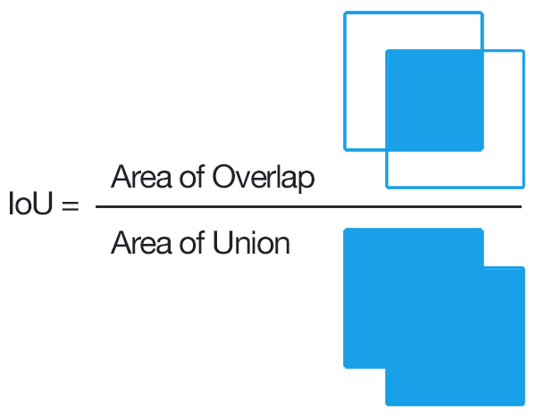
Quality Metrics
Mean intersection over union (IOU)
Non-Zero intersection ratio (nZIR)
Recall

Slide 8
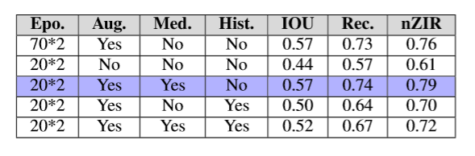
Runs
Different combinations of:
Data Augmentation (On/Off)
Median Filter (On/Off)
Histogram Equalization (On/Off)
Number of epochs

Slide 9
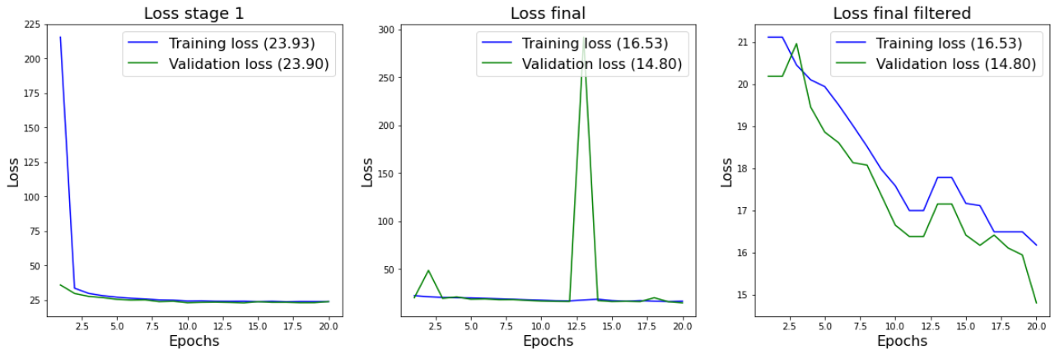
Best Run -> Median Filter

Slide 10
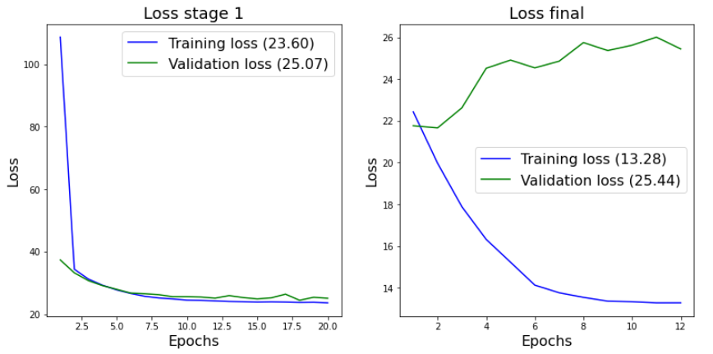
Worst Run -> no data augmentation

Slide 11
Resuls and Problems

Slide 12
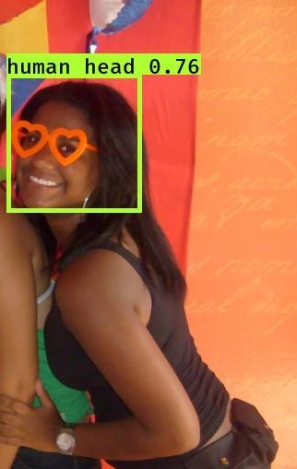
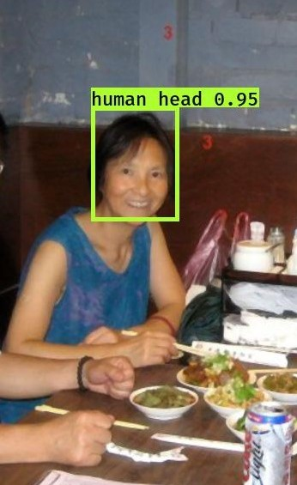
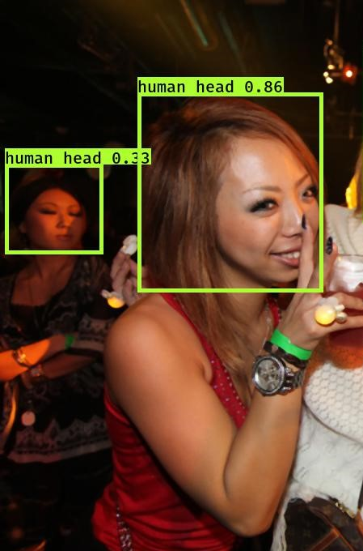
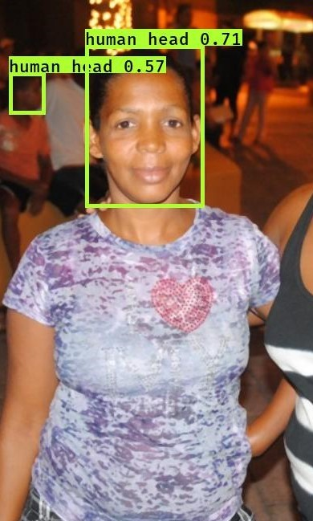

Slide 13
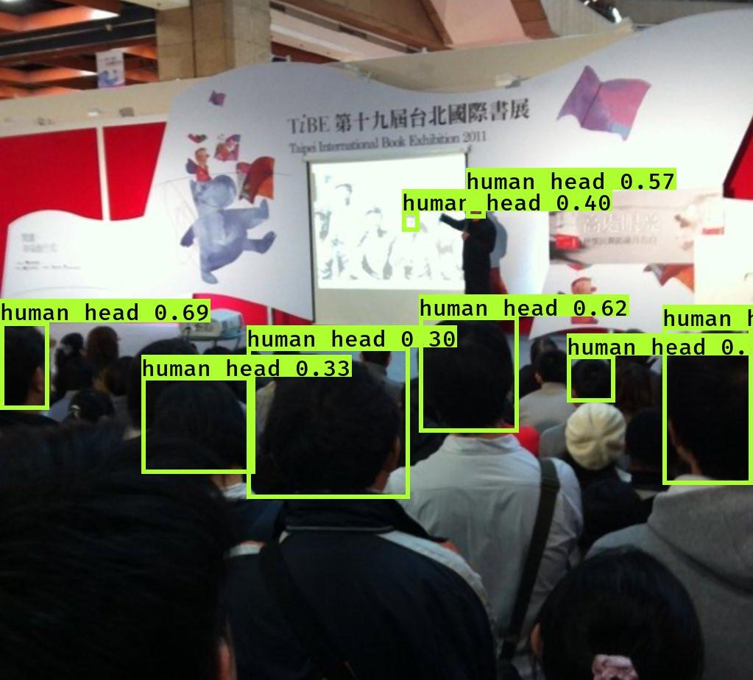
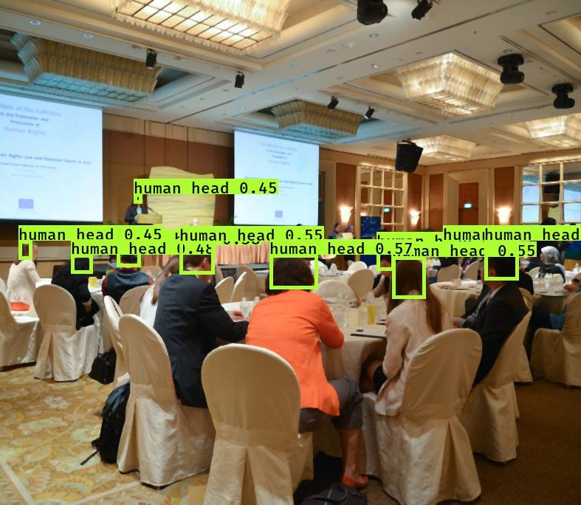

Slide 14
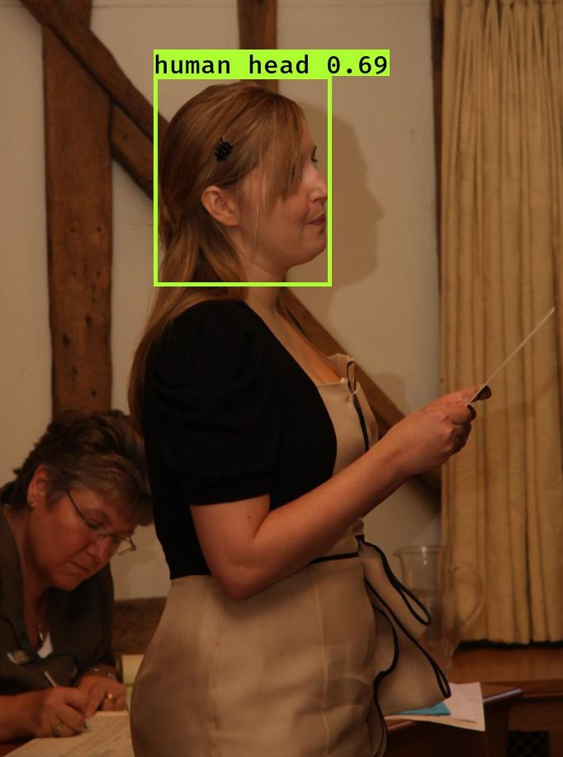
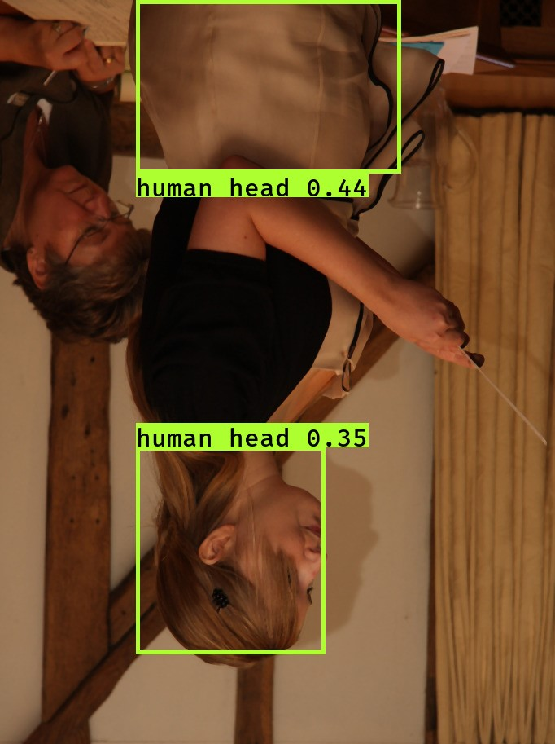

Slide 15
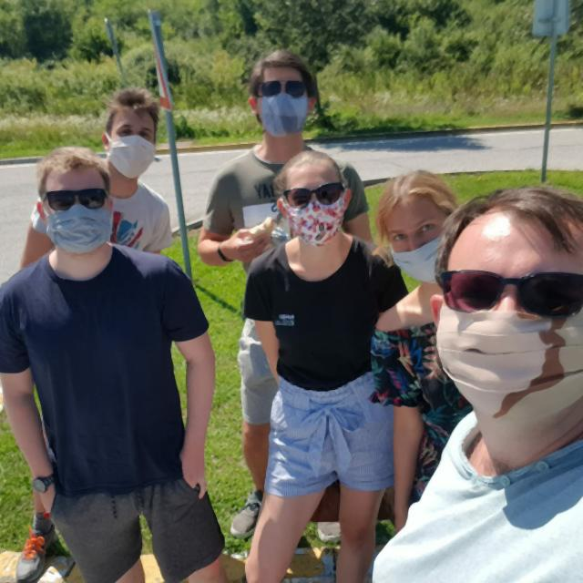
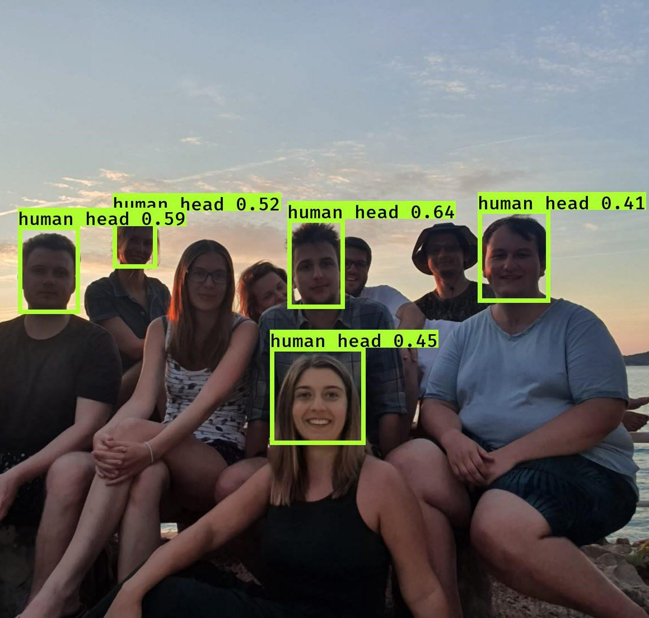

Slide 16
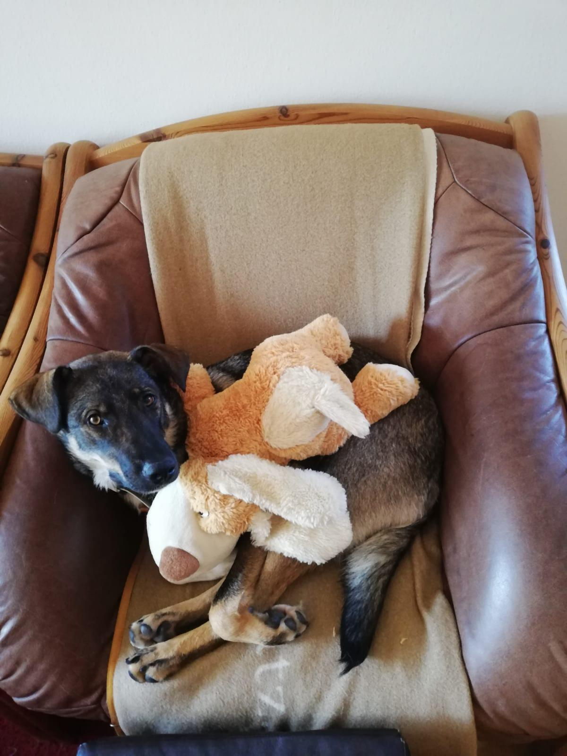
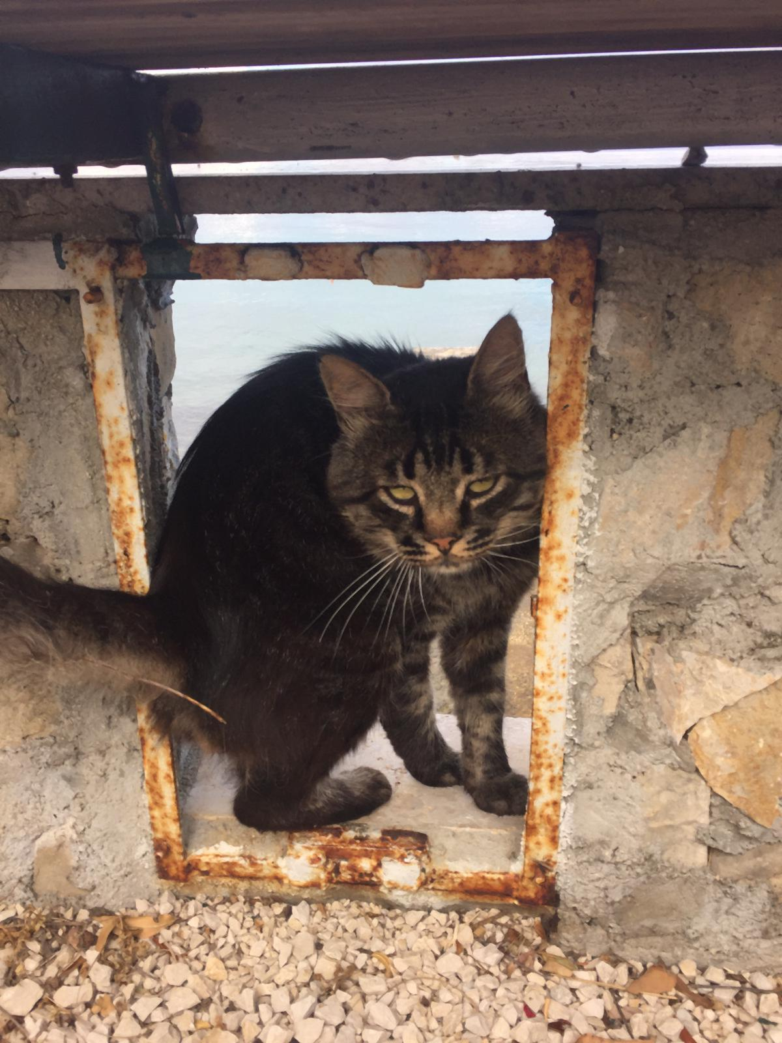
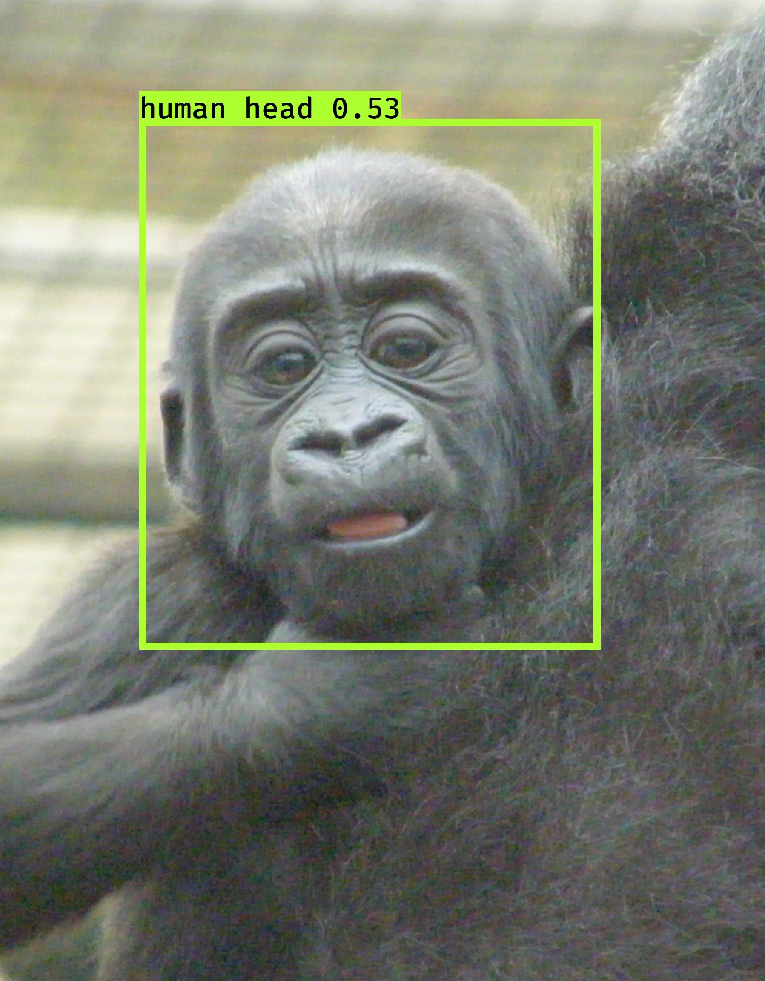

Slide 17

Questions?

